Slide 1

Recruitment Leaders Connect
The year ahead #RLCon
Today’s WiFi Access
Network: VENUE GUESTS, Password: EVENT

Slide 2
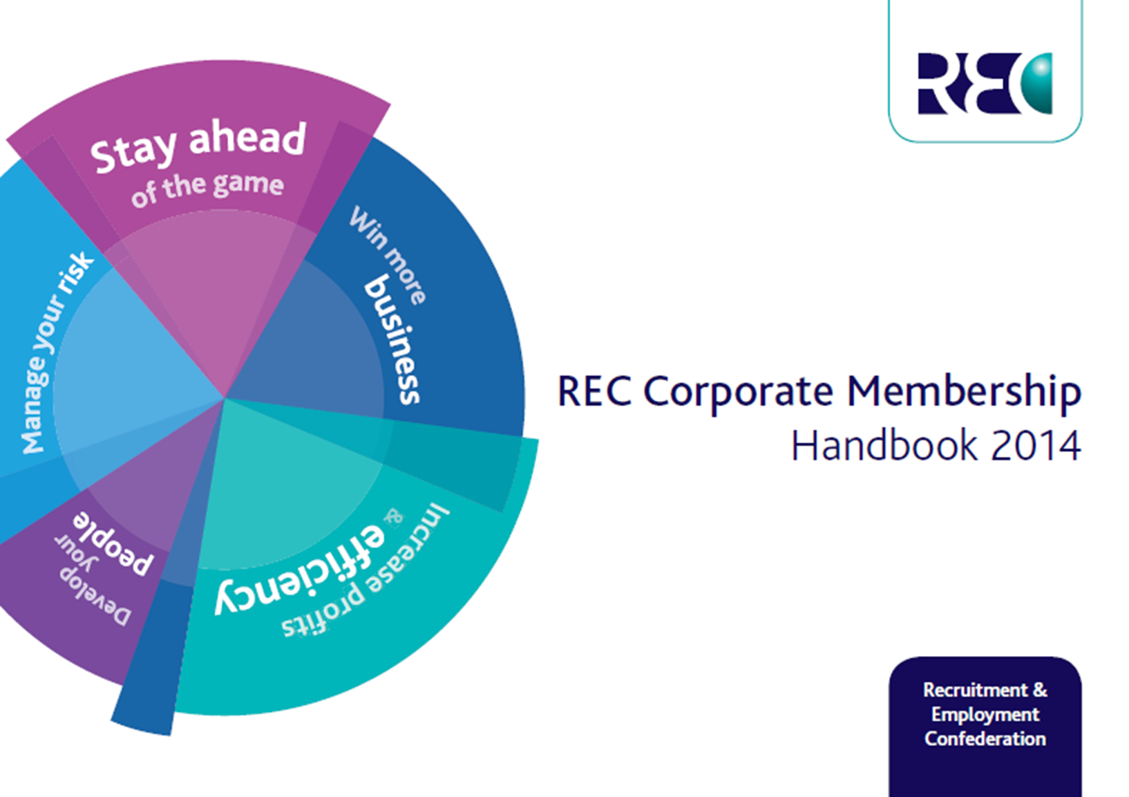
Kevin Green, CEO
13th February 2014
Recruitment Leaders Connect Summit

Slide 3
UK labour market – What's going on?
Recruitment Industry Trends
The Impending Talent Crisis
Three models of Recruitment success
The REC’s Good Recruitment Campaign

Slide 4
UK Labour Market
Economy grew by 1.9% in 2013 and forecast 2.5% in 2014
Record Employment – even with economy not back to 2008 levels
Unemployment – Falling from 7.7 in August to 7.1 %
Youth unemployment and long term unemployment still too high
Skills and talent shortages, worsening in many sectors
Perm starting Salaries rising
Immigration, living costs and productivity the key issues

Slide 5
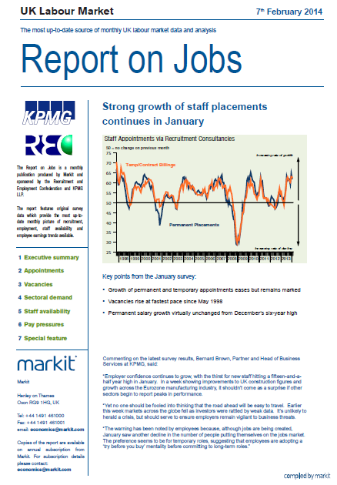
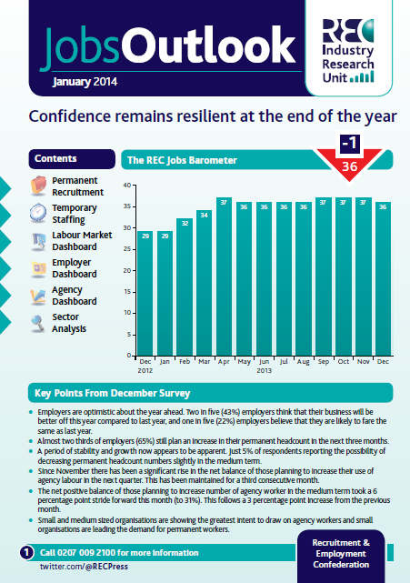

REC Jobs Data
Employment confidence increasing
Hiring intentions improving temp & Perm
65% of employers will increase their perm headcount in the next three months
Vacancies at 15 year high
Every Sector in growth
Perm jobs month on month increase since October 2012

Slide 6


Slide 7
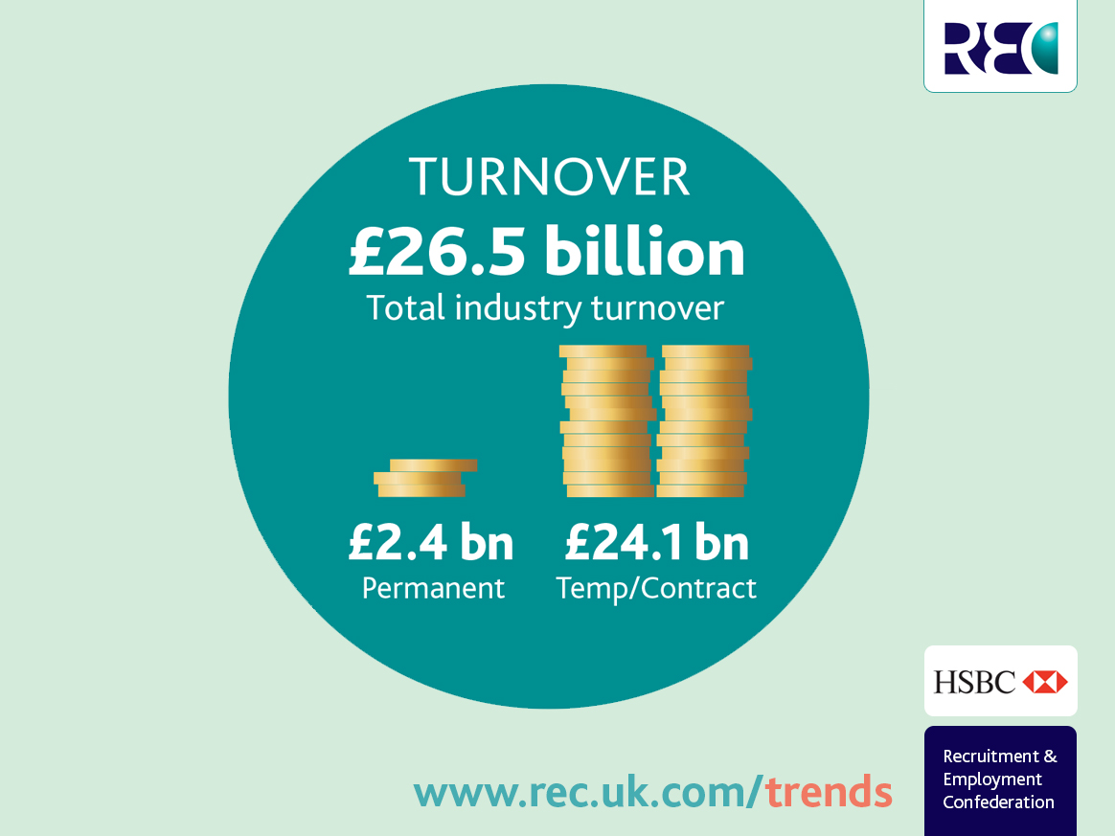

Slide 8
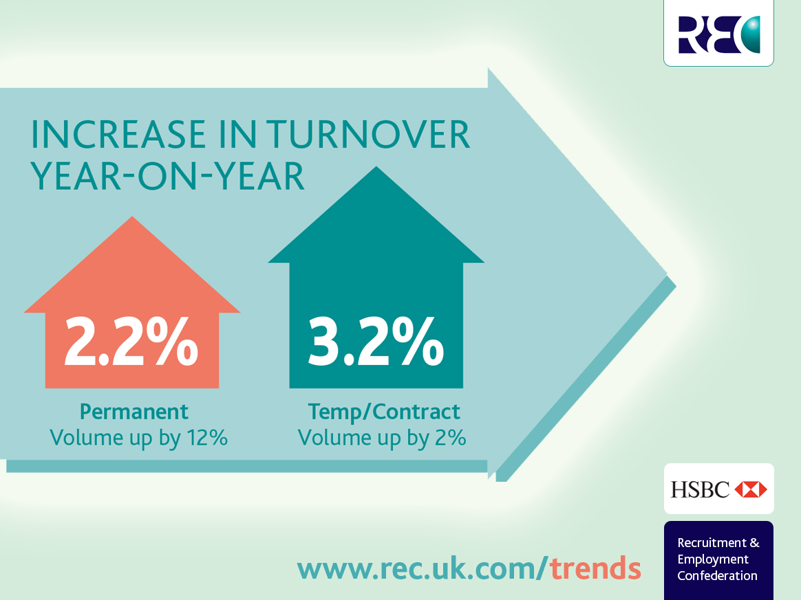

Slide 9
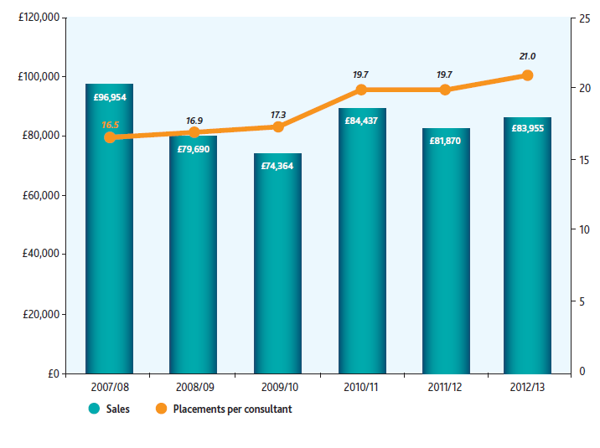
Per consultant: Permanent
Average value of sales per consultant is £83,955
Below the pre-recession peak of £96,954
Average number of placements are 21
Notes:
Average productivity level continues to increase
Average value of permanent sales per consultant is £83,955
Below the pre-recession peak of £96,954
Average number of placements are 21

Slide 10
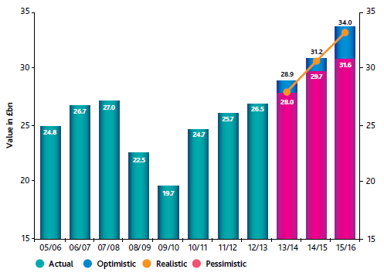
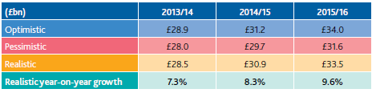
REC Industry Forecast
Notes:
Factors taken into account: GDP; wage , vacancy levels, consumer, business and recruitment industry confidence, labour supply, regulatory landscape, and technological influence.
Forecast provides an optimistic, pessimistic and realistic forecast.
Realistic forecast is for a 7.3% growth in 2013/2014; 8.3% in 2014/2015 and 9.6% in 2015/16
All three forecast predict that the industry will exceed the pre-recession peak in 2013/14

Slide 11

Emerging talent crisis

Slide 12

Two Speed Labour Market

Slide 13

Ageing Population

Slide 14




Social attitudes to work

Slide 15



Social media – opportunity and threat!

Slide 16
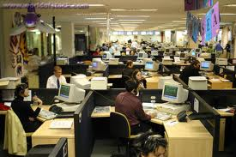
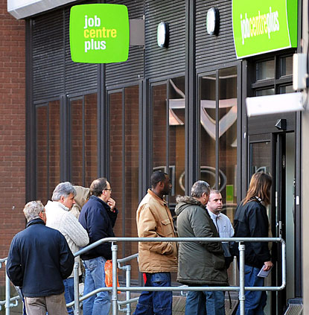
Government’s understanding of work

Slide 17

Increased flexibility
Competition
Choice
Free labour market

Slide 18

Models of Recruitment Success

Slide 19

Model 1 – The specialist Inch wide and mile deep
Deep expertise in their niche
Know where the talent is
Candidate centric model
Use content to attract candidates
Highly effective use of social media
Have global reach
Possibility of margin growth
Consultants are true consultants

Slide 20

Model 2 – The low cost operator
Often in the contingent labour market
Low margins / high volumes
Compete on compliance – process heavy
Excellent at winning tenders / PSL
Use economy of scale to create value
Growth via acquisition
May often go through intermediaries
Consultants are operators

Slide 21

Model 3 – Traditional plus
Branch model with regional focus
Generalists – temps and perm
Full service model
Often do commercial / office/ industrial
To thrive it’s about the plus
Focus on SME’s – lots of eggs in lots of baskets
Relentless focus at avoiding intermediaries / PSL
Defend margins – via relationships
Consolidate on to one site
Offer clients onsite offering

Slide 22

The REC Good Recruitment Campaign
April Go Live !

Slide 23















The REC Good Recruitment Campaign

Slide 24

Any Questions?

Slide 25
Thank You for listening
Sub heading

Slide 26
Recruitment Leaders Connect
The year ahead #RLCon
Today’s WiFi Access
Network: VENUE GUESTS, Password: EVENT

Slide 27
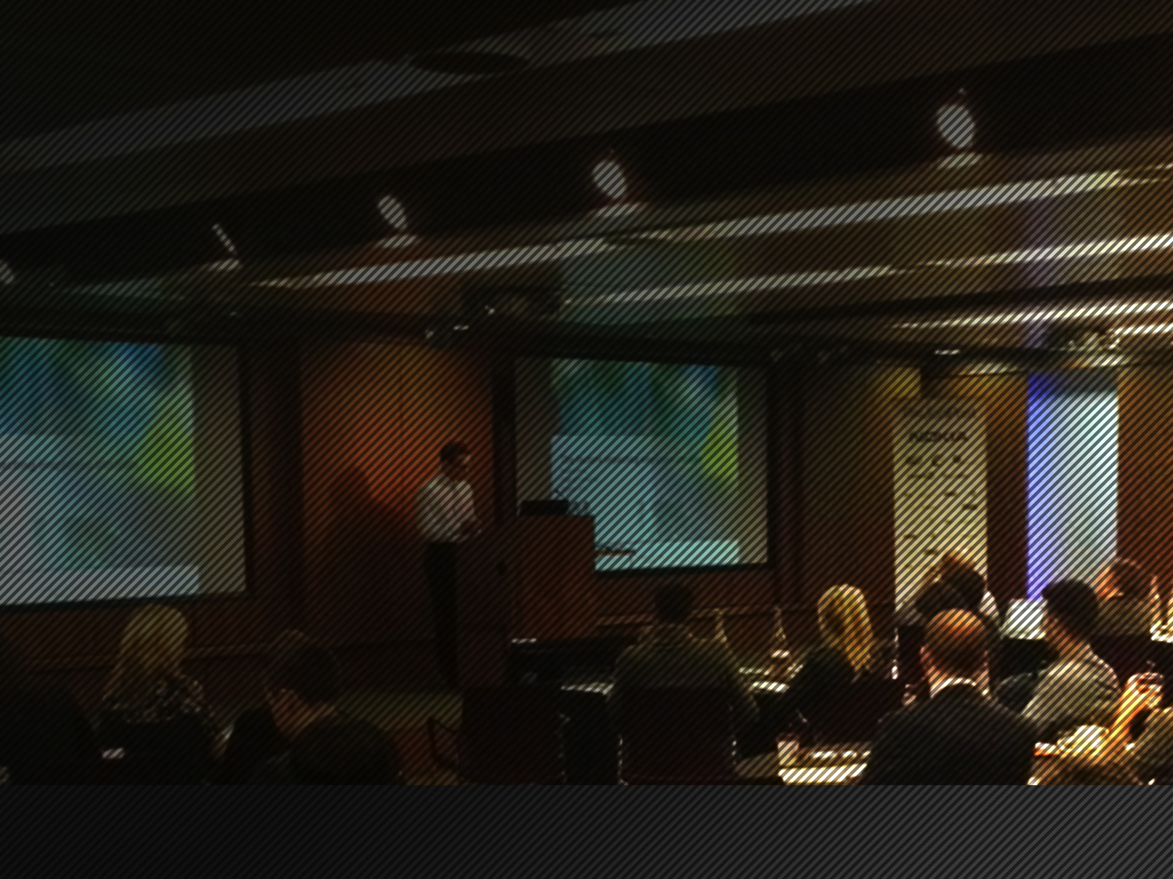

Recruitment Leaders
February 2014
Ken Brotherston
Chairman
Notes:
I set up TJP to enable companies to access the best talent easily and remove some of the inefficiencies around the recruitment industry

Slide 28
Agenda
Recruitment market drivers…a salutary tale (Part 1)
The essential qualities of today’s recruiter
Crowdsourcing and TheJobPost
Threats and opportunities in 2014

Slide 29
Recruitment market drivers
Economic cycle
  Downturn lasted a long time
  Upturn isn’t yet as strong as it needs to be
Impact of technology
  Direct hiring more effective than ever
  Rise of online databases
Recruitment business models
  MSP’s, ATS’s, RPO’s etc. now bedded in
  Industry is polarising rather than consolidating

Slide 30
Historical value proposition of Recruitment
Closing
Assessment
Identification
£
A new approach to finding talent

Slide 31
Current value proposition of Recruitment
Closing
Assessment
Identification
£
A new approach to finding talent

Slide 32
Essential qualities for today’s recruiter
Relationship oriented
  Long term view –
  take time to get to know client
  Responsive, available
  Anticipate issues and
  offer solutions
  Not cheap but takes long
  term commercial view
Trusted

Slide 33
Essential qualities for today’s recruiter
Market knowledge
  Aware of Industry/sector issues
  and impact on talent
  Knowledge of key players
  and who is up and coming
  Up to date with trends in talent,
  compensation and new
  processes/business models.
Respected

Slide 34

First identified by Jeff Howe
– Wired Magazine in 2005
A smarter way to solve complex problems
Crowdsourcing
...an open call to a large group

Slide 35









Crowdsourcing platforms that we all use
35
Notes:
Rightmove example – it changed the estate agency industry

Slide 36

Crowdsourcing in recruitment …..it’s not if or when but how
Notes:
We are here today and would be delighted to chat in more detail

Slide 37
TheJobPost - our philosophy
Our offering has to work for employers and recruiters
  Employers need access to the whole recruitment supply chain
  Recruiters need an effective economic model
Facilitation rather than management
  Let the recruiter know who the employer is
  Allow them to engage with each other
Need to cover permanent and contract
  TJP is the only platform to offer a contract solution
  Allows even the smallest firm to engage on contract roles
  Fully compliant: salary and margin paid every week

Slide 38










We deliver excellent results for these companies

Slide 39
Threats and opportunities in 2014
The ‘run faster’ model of recruitment
will continue to decline
Crowdsourcing will disrupt the industry
Effective engagement is a huge opportunity
  Consolidate your existing relationships
  Allows access and engagement with new employers
  More effective management of your BD costs
  Higher profitability
A salutary tale….part 2

Slide 40
Recruitment Leaders Connect
The year ahead #RLCon
Today’s WiFi Access
Network: VENUE GUESTS, Password: EVENT

Slide 41

Private Equity and the recruitment sector; what is the attraction?
Chris Harper
Managing Director
Baird Capital

Slide 42












About The Presenter
  25 years within private equity
  Managing Director at Baird Capital
  Significant experience of investing in the recruitment sector:
2

Slide 43
Baird in the Human Capital and
Recruitment Sector
A group-wide sector focus
Private Equity
Investing
Analysts
Research
Human Capital
Investment Banking
M&A
3

Slide 44










Human Capital Services Focus
HR Outsourcing Services
HR Technology
Unparalleled Experience
Dedicated coverage of all major human capital sectors
  Staffing
  HRO/BPO
  RPO
  PEO
  Payroll
  Benefits Admin.
  Recruiting
  HR ERP
  Corporate Training
Transaction Experience
  Over 80 M&A and equity transactions since 1995
Baird’s HCS
Platform
(1)
1) Illustrates select, relevant market participants.
HR Professional Services
4

Slide 45

A Long History and Commitment to the
Human Capital Sector
QD Group Limited
1997
1998
1999
2000
2001
2002
2003
2004
2005
Undisclosed Value
2007
2006
2007
2008
2009
2010
2011
2012
2013
5

Slide 46








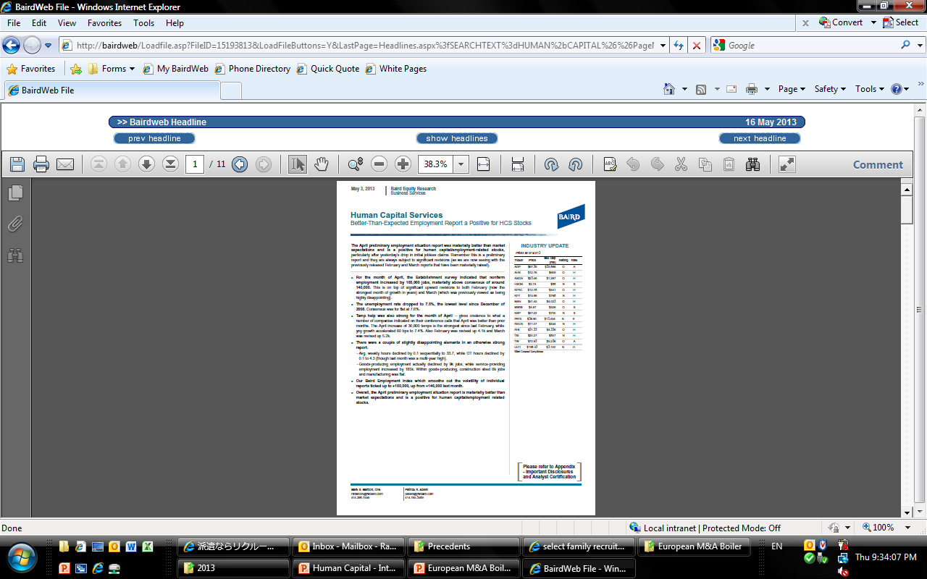
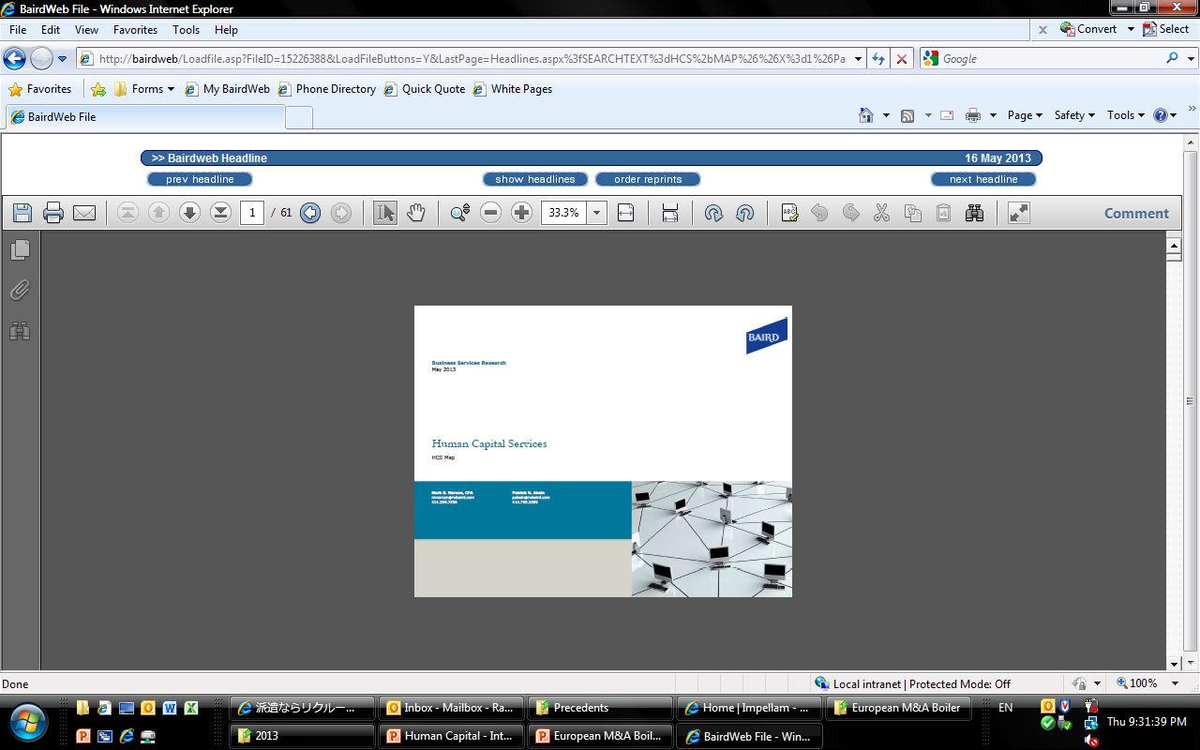



Experienced and Dedicated Research
Coverage
Mark Marcon
Current Coverage
Senior Research Analyst, Human Capital Services
Over the past 12 years, focused on building the leading position covering the Human Capital Services sector
Prior to joining Baird, spent six years with Wachovia
Publishes Human Capital Services Metrics, Analysis, and Perspective on a monthly basis (“HCS MAP”)
6

Slide 47





















Annual Business Solutions Conference
Over 700 total attendees, with 850 one-on-one meetings held
Selected 2012 Conference Attendees
19
Number of years Baird has hosted its Annual Business Services Conference
71
Number of companies presenting at the conference
194
Institutional investors in attendance
183
Private equity sponsors in attendance
2012 Key Statistics
7
Notes:
And finally we hold an annual services conference attended by the great and the good of the industry.
Indeed It was at this conference that Sean first met Allegis , as well as a number of other potential suitors.

Slide 48
Private Equity: A Quick Guide
There is a large and diverse pool of private equity investors from venture (SEP) through mega buy-out (KKR)
PE funds are increasingly offering differentiated strategies:
  Sector, geography, size, turnaround, buy and build. etc…
  But all have the same goal. To deliver strong returns to investors.
Investments are usually made from a 10 year fund
  Invest in first 5 years, realise before end of year 10
  Capital commitment from pension funds or similar seeking superior returns
  Commonly 5% of pension assets in PE funds
Performance is measured through IRR and money multiple
Key points:
  Life of funds and performance measures: dictates goal to exit within 3 to 5 years
  Superior returns sought by investors in private equity funds:
    5% per annum above risk free
    1.5x to 2.0x money multiple
  Private equity seek to invest in businesses which can deliver strong returns within reasonable risk boundaries
    2.5x money multiple
    30% IRR
8

Slide 49
Key Drivers of Returns
Enterprise Value (EV) growth
  Profit growth
  Multiple arbitrage
Cash flow
  Yield
  Debt reduction
  Refinancing
9

Slide 50
What makes the recruitment sector attractive to Private Equity?
A business where shareholders are open to investment
Large number of recruitment businesses led by hungry smart people
Proven ability to grow profits (cycles allowing)
International growth
Operationally geared
Is capable of doubling in value over 4 to 5 years
Business capable of dominating a niche
Good history of M&A, secondary buyouts and IPO markets providing exits
That could be made attractive to a buyer at the time of exit
10

Slide 51






















The evidence: some of the investments
11

Slide 52
Key Investment Criteria
Where we are in the cycle
Valuation
Availability of debt
Management hunger, alignment, depth and capability
Credible growth story
Positive market dynamic
High quality company
Clear exit potential
12

Slide 53
Investment Considerations
Geographic footprint
Scalable and repeatable
Activities, sector coverage & focus
Can I make a return out of an investment in this business
Client dependency
NFI, margins, profits, flexibility
Quality of earnings
Contract vs Perm
Management
Growth left
‘on the table’
13

Slide 54
Valuation
Primary drivers are profits and scale:
EV / 2014F EBITDA
    Medium sized players trade at a premium compared to the smallest tier…
    We observe more diversity in majors’ ratings – but overall they benefit from higher ratings
    The smallest listed players are rated the lowest…
Power trend line
Source DC Advisory
Notes:
(1) Logarithmic scale
(2) Financials calendarised to 30 June 2014
(3) Share price data taken on 28-Jan-2014
54
14

Slide 55
Select Sector Transactions
[Attention the following deals have undisclosed value:
NES
Insight Global
Pinstripe
Aston Carter
(1)
(1)
_____________________
(1) Transaction multiple based on LTM EBITDA and most recent "peak" EBITDA.
_____________________
Source: MergerMarket, CapIQ, Company filings and press releases.
15

Slide 56
Private Equity Valuations
Date | Company | Vendor | Buyer | EV | EV/EBITDA
Oct-13 | AMS | Graphite | New Mountain Capital | 260 | 12.8
Oct-12 | NES | Graphite | AEA Investors | 234 | 10.3
Oct-13 | Swift | Gresham | Wellspring Capital Management | 110 | 7.5
Jul-13 | Nigel Frank | n/a | ISIS | 44 | 7.4
Dec-12 | SR Group | Founders | Baird | ND | n/a
Oct-12 | NES | Graphite | AEA Investors | 234 | 10.3
Oct-12 | Air Energi | Palatine | LGV | ND | 7.0
Jun-12 | Fircroft | Founders | Equisitone | 140 | 7.0
Jul-12 | Nurse Plus | Founders | Key Capital | 15 | 6.5
Feb-12 | Pertemps | Founders/AIM | LDC | ND | n/a
Jul-11 | Red Commerce | Inflexion | Dunedin | 44 | 8.0
Nov-10 | Pulse | Hg | Blackstone | 75 | 6.5
Jul-10 | Teaching Personnel | RJD | Graphite | 45 | 6.9
Jun-10 | ICS | Inflexion | Blackstone | 110 | 7.0
Nov-09 | FDM | P2P | Inflexion | 25 | 4.7
Dec-08 | Air Energi | Founders | Palatine | 30 | 5.6
Nov-07 | AMS | Advent | Graphite | 100 | 12.0
Jul-07 | Teaching Personnel | Founders | RJD | 24 | 6.8
Mar-07 | Aston Carter | Founders | Baird | 42 | 7.8
Sep-06 | NES | Bridgepoint | Graphite | 86 | 8.0
Mean |  |  |  |  | 7.9
Debt availability is currently a brake on valuations at lower valuations
UK Private equity multiples are generally in the range 5.0x to 7.5x EBITDA
16

Slide 57
Recent Exits
Date |  | Holding Period | Company | Vendor | Buyer | Enterprise Value |  | Growth in EV | PE Money Multiple
Entry | Exit | Years |  |  |  | Entry | Exit
Dec-07 | Oct-13 | 5.8 | AMS | Graphite | New Mountain Capital | 100 | 260 | 2.6 | 3.5
Jun-06 | Nov-13 | 7.4 | Swift | Gresham | Wellspring | n/d | 110 | n/d | 2.0
Sep-06 | Oct-12 | 6.1 | NES | Graphite | AEA Investors | 70 | 234 | 3.3 | 4.7
Aug-09 | Oct-12 | 3.2 | Air Energi | Palatine | LGV | 30 | ND | n/a | 4.5
Dec-05 | Jul-11 | 5.6 | Red Commerce | Inflexion | Dunedin | 15 | 44 | 2.9 | 4.4
Jun-99 | Nov-10 | 11.4 | Pulse | Hg | Blackstone | ND | 75 | n/a | 3.7
Jul-07 | Jul-10 | 3.0 | Teaching Personnel | RJD | Graphite | 24 | 45 | 1.9 | 3.0
Aug-08 | Jun-10 | 1.8 | ICS | Inflexion | Blackstone | ND | 110 | n/a | 2.7
Mean |  | 5.18 |  |  |  |  |  | 2.7 | 3.6
17

Slide 58
Baird Human Capital
Case Studies
18

Slide 59

A Specialist Global Recruitment Company
NES Global Talent (“NES”) is one of the fastest growing providers of specialist personnel to the international oil & gas, power and infrastructure sectors
Industry leading productivity levels
  Achieved through the rapid identification, placement and ongoing support of highly qualified engineers globally
  Engineers paid c. £100k per annum (often materially more) for contracts typically lasting 12 - 18 months
EBITDA has increased every year since 2004, equivalent to a compound annual increase of 22%
  Driven by the Global division, which has increased both EBITDA and NFI at over 35% per annum
  Global division EBITDA has increased from less than £2m to over £20m since 2004
2012F NFI and EBITDA of £59m and £24m, respectively
Attractive end markets with long term growth prospects
High barriers to entry in global markets
Highly fragmented market in which NES is a sector leader
  Well placed to lead consolidation and become the global market leader
Headquartered in the UK, serves clients through a global network of 32 offices and employs c. 450 staff
19

Slide 60


Case Study: £105 million Debt
Refinancing of NES (June 2012)
NES required increased working capital facilities with greater operational flexibility to support 20%+ p.a. international growth
A broad group of traditional and alternative lenders were approached to participate in the enlarged working capital and term loan facilities
RBS led a club with HSBC and Lloyds to provide a £105 million, 5-year committed debt package consisting of:
  £25 million term loan
  £40 million invoice discounting facility
  £40 million committed revolving credit facility
The lenders indicated that an additional £25 - £30 million of acquisition financing could be available to a purchaser
Traditional Lenders Approached
Alternative Lenders Approached
20

Slide 61
Case Study: £234 million sale of NES to
AEA Investors (October 2012
A select group of potential private equity and strategic buyers were introduced to the management team prior to the formal process launch
  Significant buyer interaction with the management team was encouraged throughout the process
Financial, commercial, legal and insurance vendor diligence reports were prepared to facilitate potential buyers review of the global business
Eight indications of interest were received in August, with five potential buyers invited to proceed
Prior to management presentations scheduled for early September, potential buyers were encouraged to progress their due diligence and financing discussions with lenders
Following the management presentations, one potential buyer attempted to pre-empt the process
  Diligence continued with four other potential buyers
Three final offers, with SPA mark-ups and no outstanding diligence, were submitted less than four weeks after management presentations
All three bidders elected to roll the existing debt financing structure to increase the deliverability of their offers
AEA signed the transaction within 72 hours of the final bids being submitted
  Graphite realised a money multiple in excess of 4.5x
AEA, with significant experience in the oil & gas sector and developing the international profile of its portfolio companies, will support the management team through NES’ next growth phase
Highly Targeted Process
15 Information
Memorandums Distributed
July
8 Indications of
Interest Submitted
August
5 Management
Presentations Held
September
3 Final Bids with SPA
Mark-ups
October
21

Slide 62




Aston Carter: A Case Study
Aston Carter CEO, Sean Zimdahl;
“Baird Capital Partners Europe has been a great partner. The team brought deep sector knowledge and investment experience to our business, which really helped us develop the initial growth strategy. Then through tougher markets they were highly supportive of managing the cost base and retaining the key people at a level that enabled the business to grow quickly as markets improved. Their operational expertise and international network was a real help.”
Aston Carter
Baird US introduced the acquirer of the business
Actions:
Accessed Baird resources to develop strategy for overseas growth and exit
Introduced operating partner John Hubert as non-executive Chair, helped development of senior management structure to aid international development
Incentivised the senior managers to drive continued growth
Significantly improved MIS reporting and financial/cash management to support growth
Baird US introduced the acquirer of the business
Results:
Geographic expansion (Netherlands, Singapore, Hong Kong, UK, France, Sweden)
Built the customer base significantly by further penetrating core FS sector customers, developing new customers and growing consulting/corporate accounts
Paid debt down c. 40%
Rapid execution of strategy supported the business in the recession and has enabled rapid profit growth early in the recovery
‘2012 Mid-Market Management Team of the Year’
Value Creation
(£ in millions)
22

Slide 63
Baird Human Capital
What about 2014
23

Slide 64
Prospects for 2014
Increasing volume of M & A transactions
  Economic cycle attractive
  Pent up demand
    Buyers:
      Trade seeking access to growth markets and people
      PE: Need to deploy capital
    Vendors:
      PE need to exit to deliver returns to investors
      owner managers seeking return on hard work
A return of the IPO?
  Excess capital seeking a home
  Exit for larger PE backed businesses?
24

Slide 65
Summary
Sector is attractive to private equity buyers
Valuations are: 5.0x to 7.5x LTM EBITDA
Debt availability is currently a brake on both valuations and ability to execute
  Questionable availability below £10m
  Perfect track record required
  Alternative lenders (at a price)
Critical success factors include:
  Management depth and quality
  Clear focus and discipline
  Credible growth story
  Scale and geography
  Exit planning: Ultimately being able to answer the question...Who will buy and why?
25

Slide 66
Thank You
26

Slide 67
Recruitment Leaders Connect
The year ahead #RLCon
Today’s WiFi Access
Network: VENUE GUESTS, Password: EVENT

Slide 68
Bill Boorman: http://prezi.com/hpaoszlsifov/recruiting-technology-2914/?utm_campaign=share&utm_medium=copy

Slide 69
Recruitment Leaders Connect
The year ahead #RLCon
Today’s WiFi Access
Network: VENUE GUESTS, Password: EVENT

Slide 70
The Mobile Opportunity
Matt Alder
matt@metashift.co.uk

Slide 71

@mattalder

Slide 72
What I’m going to talk about
The Mobile Landscape
Opportunity: Conversion
Practicalities / Case Study

Slide 73
Landscape

Slide 74
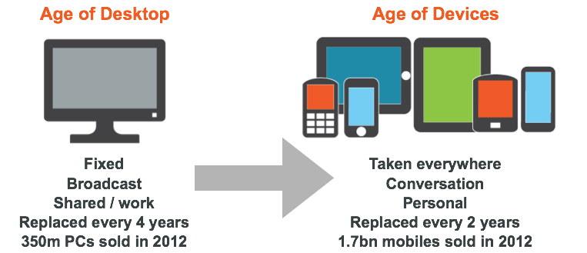
A New Age

Slide 75
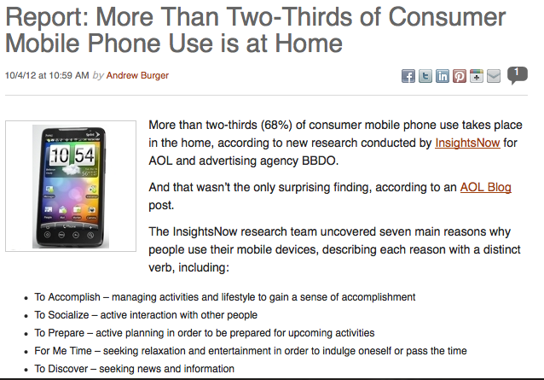
Mobile isn’t actually mobile
Notes:
It becomes so important when you realize that the mobile internet is becoming people’s preferred access point even in their own homes

Slide 76
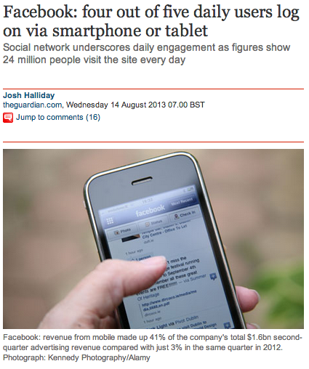
Mobile and Social

Slide 77

Mobile & Search
Google expects a site to load on a smartphone / tablet in 1 second

Slide 78
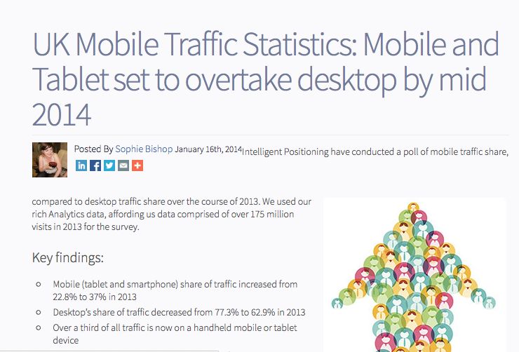
Big News….

Slide 79
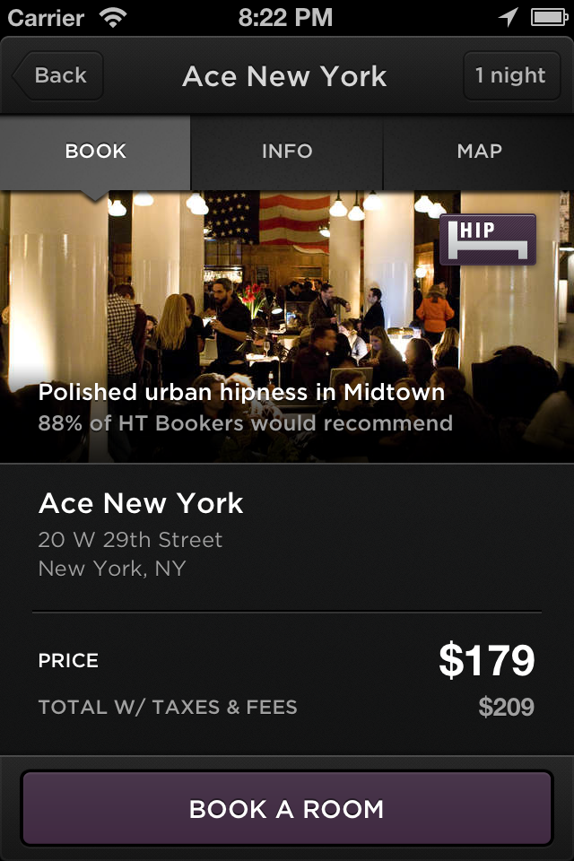
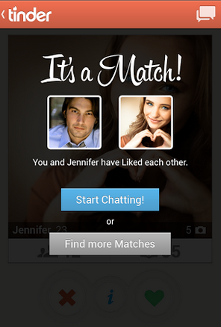
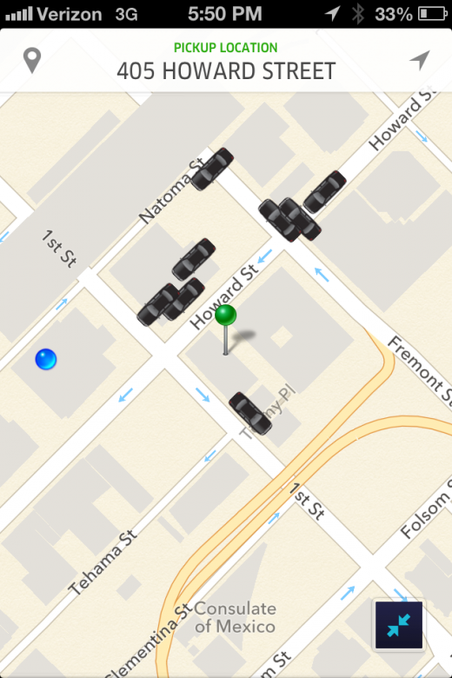
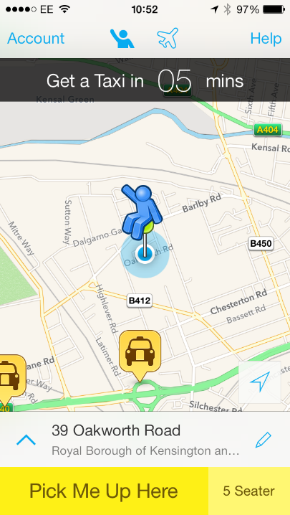
Mobile First Disruption
Hotel Tonight
Tinder
Uber
Hailo

Slide 80
Action Orientated Medium
70% of mobile searchers act within an hour; only 30% of PC searchers do
Source Mobile Marketer

Slide 81
What about Recruitment?
88% of UK Job Seekers have used a mobile device to search for jobs in the last year
Google Consumer Survey 2013

Slide 82
Recruitment = Exponential Growth
approx 40%
% Job Board mobile web traffic
2010
Now
SOON

Slide 83
Conversion

Slide 84
Online Candidate Attraction
Social Media
At least 60% on mobile
SEO
Google desktop search declining
Apply or Register
Persuasion
More personal email read on mobile / tablet
Email
20% to 30% of recruitment web traffic on mobile
Advertising

Slide 85
Social Media
At least 60% on mobile
How much talent is being leaked?
Can you multiply ROI on current activities?
SEO
Google desktop search declining
More personal email read on mobile / tablet
Email
20% to 30% of recruitment web traffic on mobile
Advertising

Slide 86
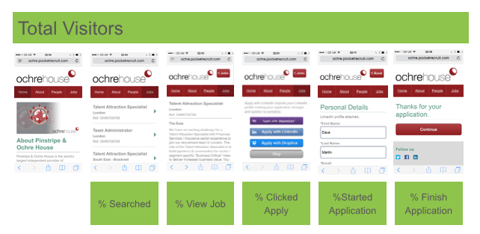
Optimisation & Conversion Rates

Slide 87
Practicalities

Slide 88
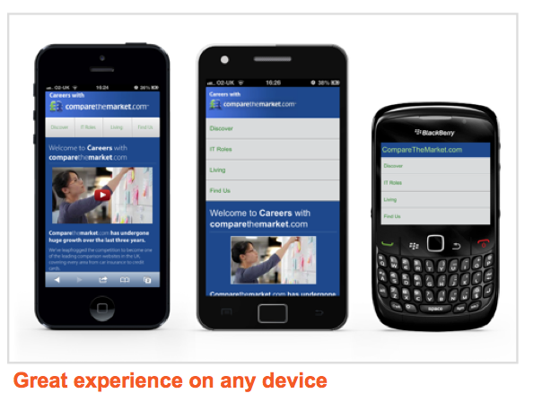
Adaptive (Device Specific) Design

Slide 89
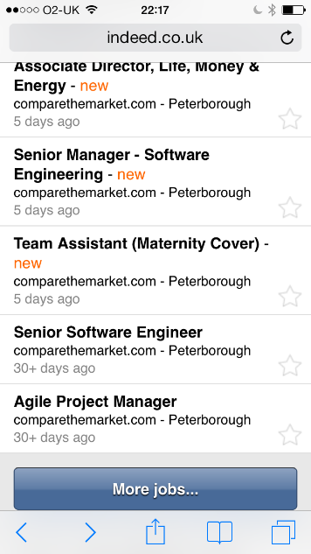


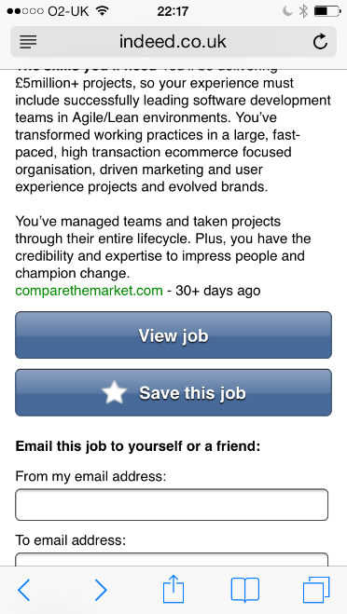

Candidate Journey and Cloud Apply
Indeed Search for Software Engineers in Peterborough
Career micro-site selling the opportunity
Cloud Apply

Slide 90
Key Points
The majority of your traffic will soon be mobile
The opportunity and the threat is enormous
Experiment and Optimise
Work on every device (Adaptive Design)
Reduce registration / apply friction

Slide 91
matt@metashift.co.uk

Slide 92
Recruitment Leaders Connect
The year ahead #RLCon
Today’s WiFi Access
Network: VENUE GUESTS, Password: EVENT

Slide 93

LinkedIn and the future of Recruitment
Rebecca Drew
  Enterprise Account Executive EMEA
  Search & Staffing
  LinkedIn
Notes:
I am going to talk about 4 things:
LinkedIn
Changing world of Recruitment- survey
What you can be doing for free
Very brief overview of our paid for solutions

Slide 94

LinkedIn: A global pool of talent
13M+
4M+
1M+
UNITED KINGDOM
NETHERLANDS
BELGIUM
7M+
5M+
2M+
9M+
FRANCE
SPAIN
TURKEY
CANADA
6M+
1M+
1M+
ITALY
SWEDEN
DENMARK
93M+
UNITED STATES OF AMERICA
1M+
24M+
2M+
2M+
SAUDI ARABIA
INDIA
INDONESIA
PHILIPPINES
1M+
1M+
1M+
16M+
UNITED ARAB EMIRATES
MALAYSIA
SINGAPORE
BRAZIL
5M+
AUSTRALIA
3M+
1M+
SOUTH AFRICA
NEW ZEALAND
277M+
+2
New members per second
Members
worldwide
187M
Monthly unique visitors
Notes:
>2 New members per second as of 12/31/13 based on internal estimates
187M Monthly unique visitors for Q4’13 according to comScore using LinkedIn + SlideShare
http://press.linkedin.com/about

Slide 95





















Connect the world’s professionals to make them more productive and successful
Notes:
Our mission statement

Slide 96

The global economic graph
Opportunities
Skills
Companies
Educational
institutions
People
Professional
knowledge
Notes:
Map all of these -

Slide 97
The global economic graph
Opportunities
Skills
Companies
Educational
institutions
People
Professional
knowledge
Notes:
Efficient vehicle to connect talent and opportunity. Job liquidity – massively important part of this graph

Slide 98















































Members First
Notes:
the first value of the company is members first.
Any time we want to do something new the first question we ask is, “How will this impact the individual member around the world?”- and if it’s not a positive way, then those ideas are cast aside.

Slide 99

The Social Web
Social networking has
changed the behavior of
online users.
Changes the way users
- Process information
- Make buying decisions
- Look for employment
People expect information to be relevant and personalised.

Slide 100




What is Social Recruiting?
Social Recruiting is building a community of relevant followers who you can market to and in turn leverage their networks for business success

Slide 101
Clients
Candidates
Consultants

Slide 102





Hire
Engage the world’s best passive talent for clients and internally
Market
Engage most effectively and efficiently with professionals
Sell
Engage decision makers and build trust with Clients
Notes:
To engage the worlds best passive talent, you need to have a strategy in place that allows you to ‘segment’ ‘target’ and ‘position’
Engaging the right professional with the right brand message requires
identify the right person
engage them with content that is compelling; and
spur them to an action. This is what LinkedIn enables, better than anyone else.
Your peers are telling us that social professional networks have already changed the way they find talent for their clients. In a recent survey that we conducted for the UK they named social professional networks the #1 long-lasting trend in recruitment and identified them as by far the #1 source of quality placements.

Slide 103
What you should be doing for FREE

Slide 104
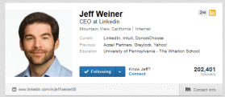
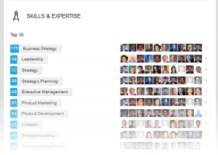
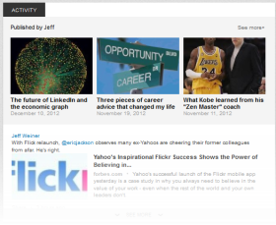
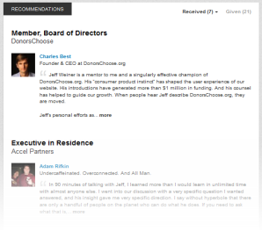
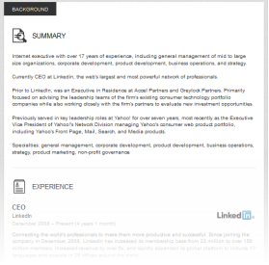
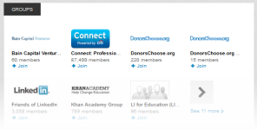
Identity: build personal, professional brand
Your visual identity and headline
Skills & Expertise
Photo
Headline
Updates
Summary
Thought Leading Updates
Recommendations
Summary and Experience
Groups &
Associations

Slide 105
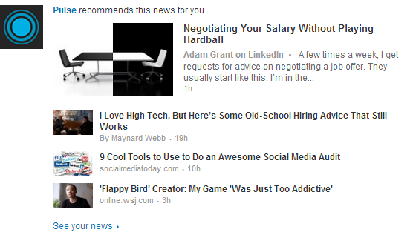
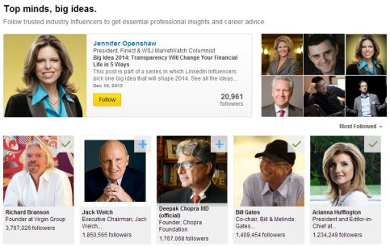
Insights: share and learn knowledge
Pulse
Thought-leadership
Relevant, recommended news
Engaging, informative insights

Slide 106
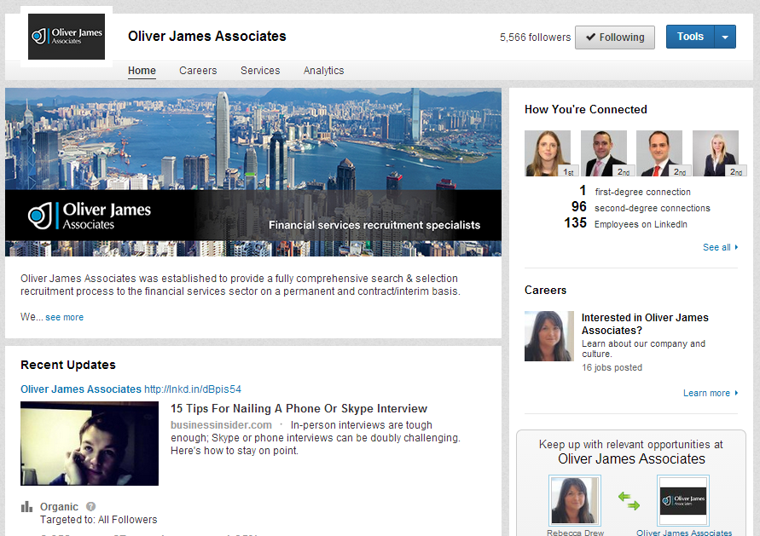
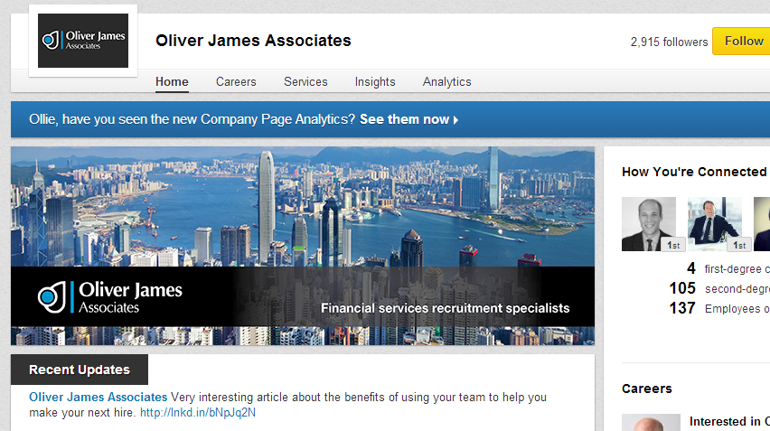
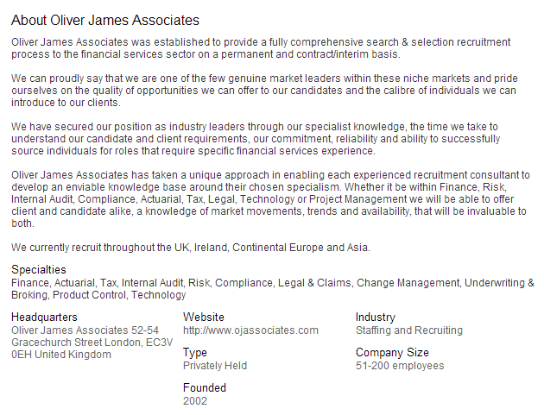

Slide 107

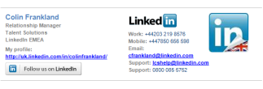




Add insights to improve your workflow and efficiency
Outlook Integration
Email Signature
Google Toolbar
PlugIns & APIs

Slide 108
Why are followers important..
61%
of members are more likely to share information as a result of following a company
3x
more likely to apply for jobs posted by companies they follow
6x
more likely to view your Careers Page
78%
more likely to accept an approach
Notes:
.

Slide 109
Social Recruitment Best Practice
Social Recruitment
Build Followers
Leverage Ad Impressions
Leverage Consultants
Establish Branding
Right Job
Right Person
Proactive Headhunting

Slide 110
LinkedIn Data Insights

Slide 111
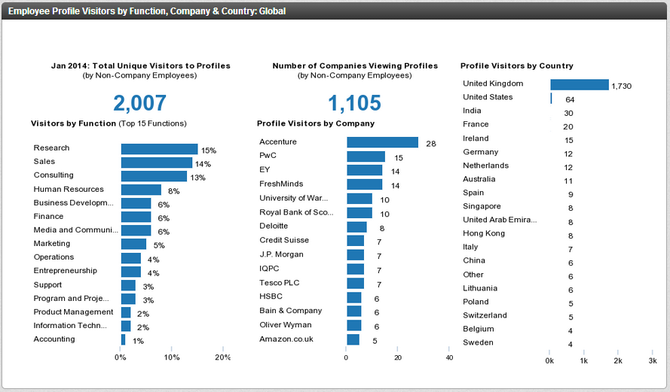
Employee Profile Views

Slide 112

FREE LinkedIn Audit with Data Insights for all Attendees

Slide 114
Recruitment Leaders Connect
The year ahead #RLCon
Today’s WiFi Access
Network: VENUE GUESTS, Password: EVENT

Slide 115
Recruitment Trends 2013
Dan Martin, Broadbean

Slide 116

Download UK Recruitment Trends 2013

Slide 117
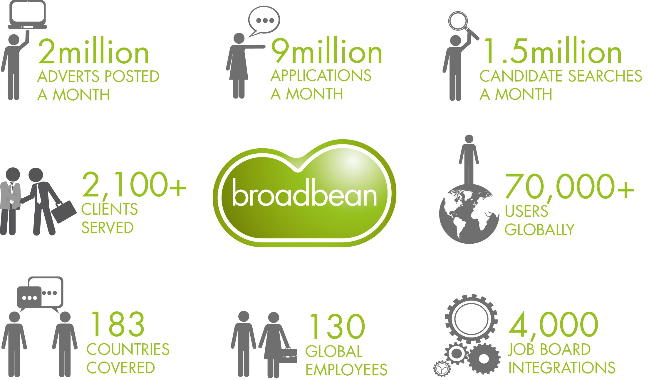
UK Recruitment Trends 2013

Slide 118




Like A Phoenix From the Flames!
UNEMPLOYMENT: fall in jobless total is second biggest on record, renewing speculation about interest rate rise
Unemployment Rate Falls To
7.1% In Job Surge
The International Monetary Fund is on the brink of upgrading its growth forecast for the UK more than
any other major economy
Britain powers ahead of the rest of Europe:
IMF upgrades UK growth for 2014 to 2.4% just a year after warning Osborne he was 'playing with fire' by imposing cuts

Slide 119

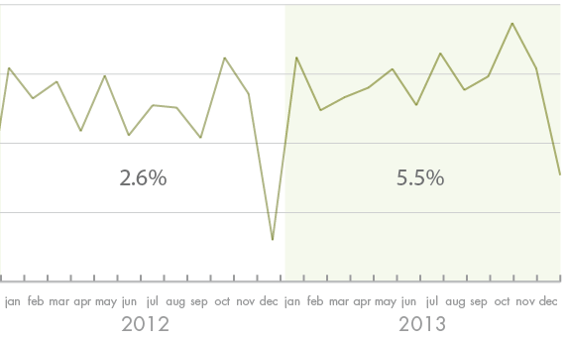
But what does the data show?
VACANCIES GROWTH

Slide 120
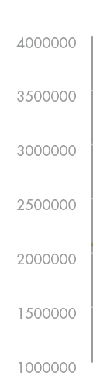
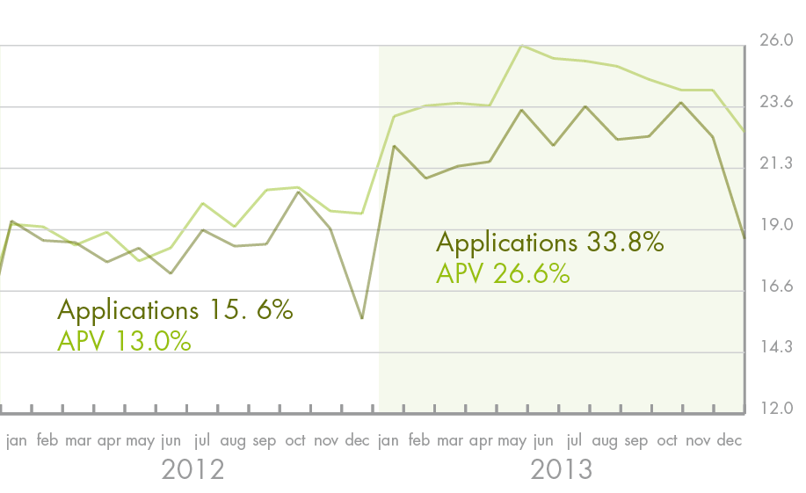
But what does the data show?
APLICATIONS GROWTH

Slide 121
Digging beneath the headlines
The majority of sectors saw growth in vacancies in the year
18
30

Slide 122
Digging beneath the headlines
Top performing sectors
1
+ 47.0% AUTOMOTIVE
2
+ 44.8% MEDICAL & NURSING
3
+ 42.1% BUILDING & CONSTRUCTION
4
+ 35.6% PUBLIC SECTOR
5
+ 32.6% TRANSPORT & RAIL

Slide 123
Digging beneath the headlines
Worst performing sectors
1
- 12.0% TRAVEL & TOURISM
2
- 9.4% GRADUATES & TRAINEES
3
- 6.9% RETAIL
4
- 6.8% SENIOR APPOINTMENTS
5
- 6.6% INSURANCE

Slide 124












Some regional surprises
Scotland + 3.2%
Northern Ireland + 3.9 %
North + 8.8%
South, East & London + 2.4%
Midlands + 14%
Wales + 18.3%

Slide 125
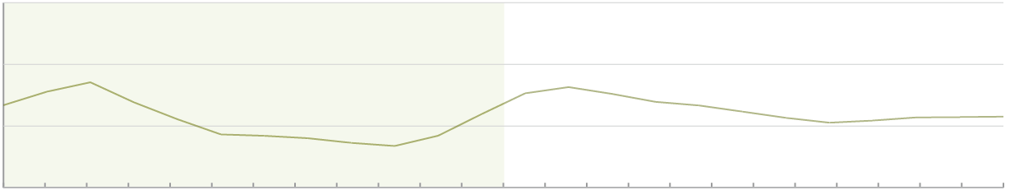
Improvements yet to hit the pay packet
Salary Trends
36000
34000
32000
30000
2013 Growth 1.2%
jan feb mar apr may jun jul aug sept oct nov dec jan feb mar apr may jun jul aug sept oct nov dec
2012 2013

Slide 126
Improvements yet to hit the pay packet
Moving in the right direction
1
+ 8.3% AUTOMOTIVE
2
+ 5.1% SCIENCE & RESEARCH
3
+ 4.7% CALL CENTRE & CS
4
+ 4.2% SENIOR APPOINTMENTS
5
+ 2.8% PROCUREMENT

Slide 127
Improvements yet to hit the pay packet
Yet to see an improvements
1
- 16.0% TELCOMMUNICATIONS
2
- 12.1% BANKING
3
- 10.9% FASHION
4
- 10.2% PHARMA
5
- 9.2% AEROSPACE

Slide 128
Some sectors out of balance
60
55
50
45
40
35
30
25
20
15
10
5
0
-5
-10
60
55
50
45
40
35
30
25
20
15
10
5
0
-5
-10
Hospitality & Catering
Retail
HR & Personnel
Banking
2013 APV
Accountancy
Recruitment
Building & Construction
IT
Manufacturing
Financial Services
Sales
Marketing
Fashion
FMCG
Engineering
Education & Training
Social Care
Insurance
Automotive
Electronics
Pharma
Legal
Medical & Nursing
-8 -6 -4 -2 0 2 4 6 8 10 12 14 16 18 20 22 24 26 28 30 32 34 36 38 40 42 44 46 48 50
2013 Vacancy Growth (%)

Slide 129

Spotlight on Recruitment

Slide 130
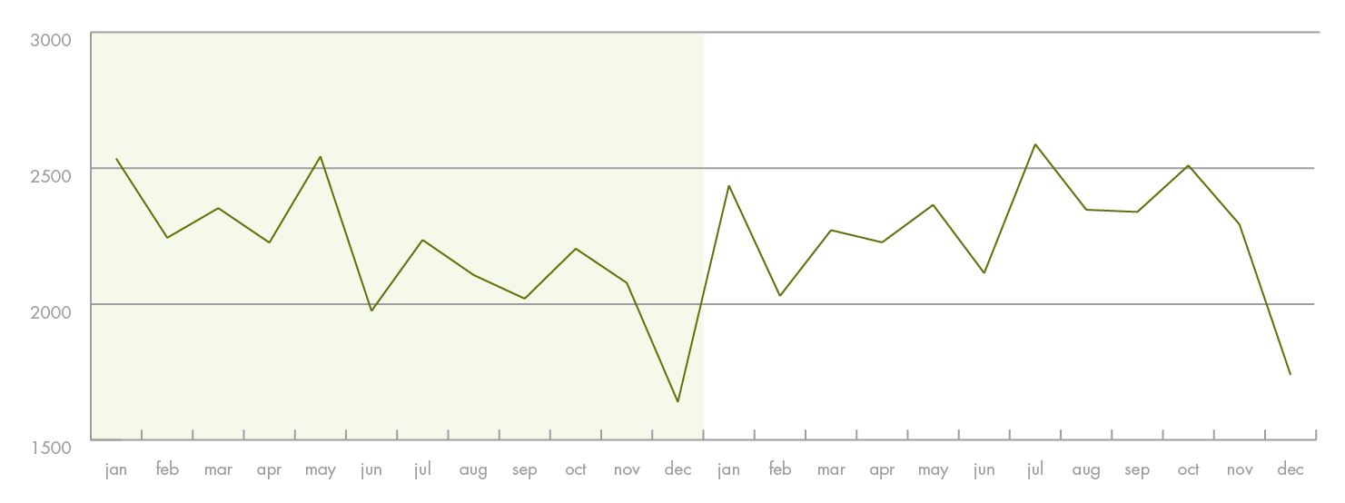
Recruitment under review…
Vacancy changes in the Recruitment sector
Full year growth 4.2%
Last 6 months growth 12.5%

Slide 131
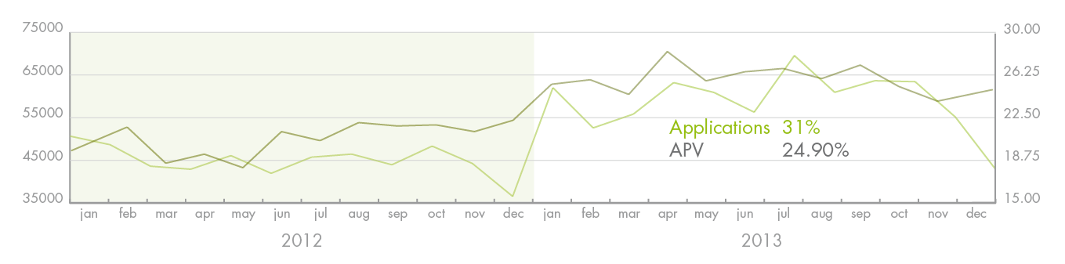
Recruitment under review…
Application Rate Trends in the Recruitment sector

Slide 132
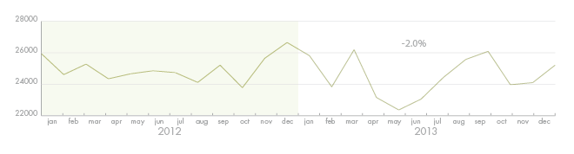
Recruitment under review
Salary movements in the Recruitment sector
Last 12 months - 2.0%

Slide 133
Download UK Recruitment Trends 2013

Slide 134
Thank You!
Dan Martin, Managing Director
danm@broadbean.com
+44 (0)20 7536 1661
Tweet @BroadbeanEMEA
Follow Broadbean Technology on Linkedin
Friend Broadbean Technology on Facebook

Slide 135
Recruitment Leaders Connect
The year ahead #RLCon
Today’s WiFi Access
Network: VENUE GUESTS, Password: EVENT

